Slide 1
Piecewise Functions
Notes: 9/16

Slide 2

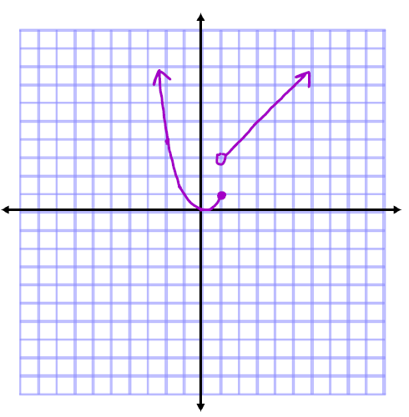
Piecewise functions

Slide 3
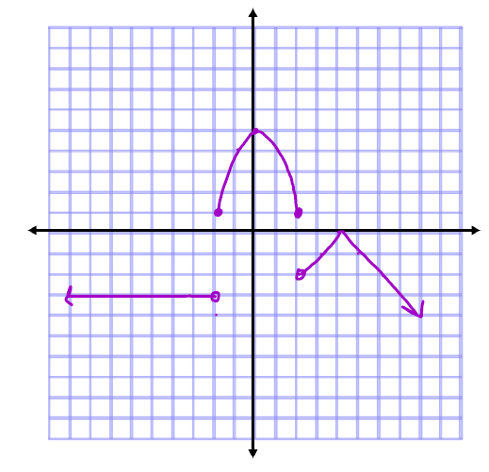

Piecewise functions

Slide 4






Evaluating piecewise functions

